Slide 1


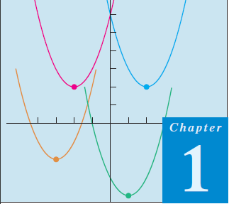
Thomas Calculus 11th
02
Function
Samuel Lukas

Slide 2
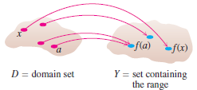

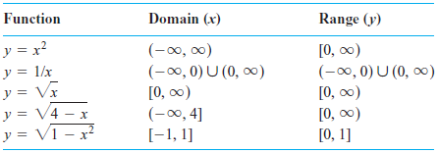
Function
A function f from a set X to a set Y is a rule that assigns a unique (single) element of X,

Slide 3
Domain of Function
Find the domain of
Find the domain of

Slide 4
Examples
Find the domain and the range of the given function :

Slide 5
Exercises 01
Find the domain of these functions :
01.
02.
03.
04.
05.
06.
07.
08.
09.
10.

Slide 6
Injective and Surjective function
is injective or one to one function if
is surjective or onto function if
is not injective function, Why ?
Is surjective function, Why ?

Slide 7
Exercises 02
Prove these statements:
01.
Is one to one function
02.
Is one to one function
03.
Is surjective function
04.
Is ont to one onto function

Slide 8
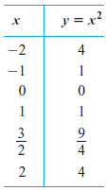
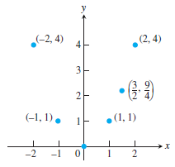
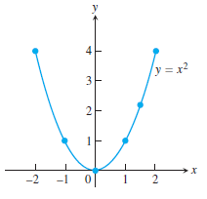
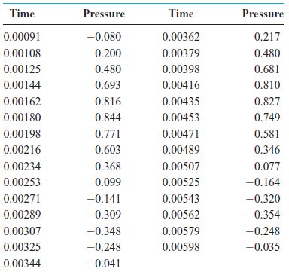
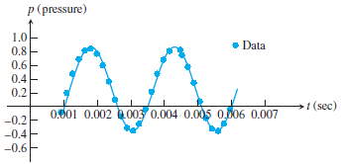
Graph of the function (1)
1. Graph the function over the interval [-2,2]

Slide 9
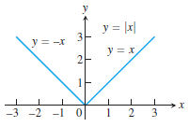
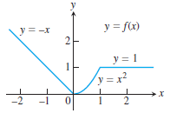


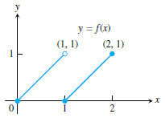

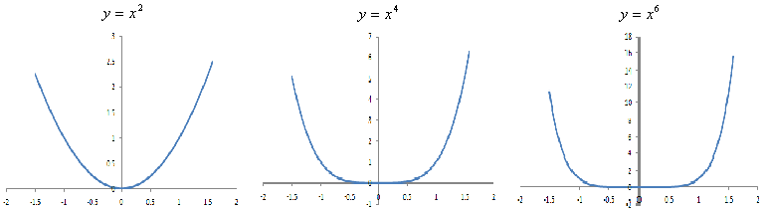
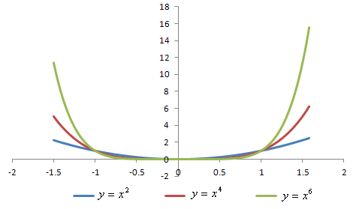
Graph of the function (2)
2.
3.
4.
5.

Slide 10
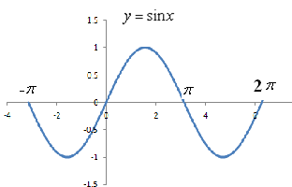
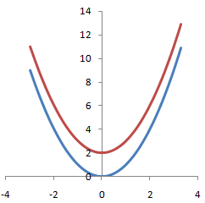
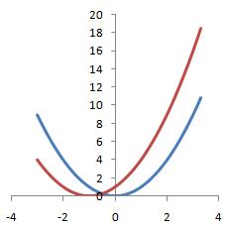
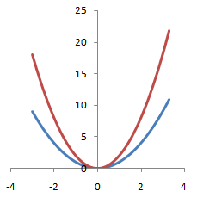
Graph of the function (3)

Slide 11
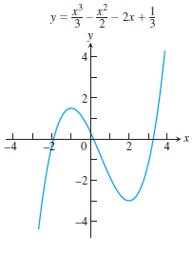
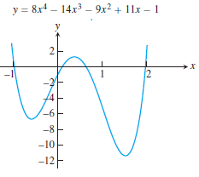
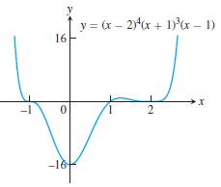
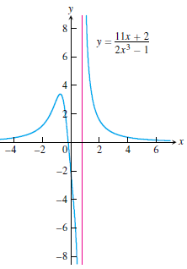
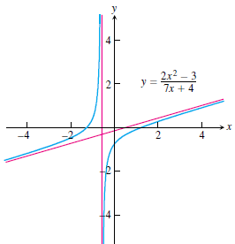
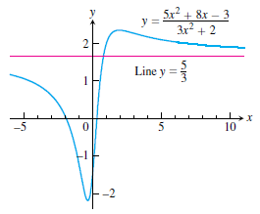
Graph of the function (4)

Slide 12
Exercises 03
Draw the graph of these function:
01.
02.
03.
04.
05.
06.
07.
Graph
from
08.
09.

Slide 13
Types of The Function
Exponential Function
Logaritmic Function
Hypherbolicus Function

Slide 14
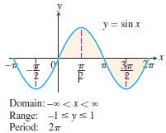
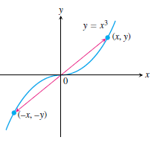
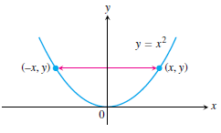
Characteristics of Function
Periodical Function
Odd Function
Even Function

Slide 15
Composition Function

Slide 16
Inverse Function
Assume is one to one onto function and is a function that then is inverse function of . It is written as or

